Slide 1

Predicting Cyber-Attacks in IoT Environment
Presented by Arwa Alamoudi

Slide 2
Outline
What is IoT?
Problem Statement.
Work Process.
Conclusion and Future Work.

Slide 3

What is IoT?

Slide 4
Internet of Things (IoT) is communication networks of a variety of things or objects around us that have the ability to send and receive data and information with each other through unique addressing scheme to achieve a service or goal without the need of human-to-human and human-to-computer interaction

Slide 5




IoT Example

Slide 6

4.7 billion things
11.4 billion things
21 billion things
In 2016
By 2021
By 2025

Slide 7
What is the problem then?

Slide 8

The Problem

Slide 9
The Goal
Build a model that acts as a secure infrastructure for IoT systems through predicting attacks in network transmissions

Slide 10
The Process
Sampling
Evaluation
Data
Preprocessing
Data Collection
Data Cleaning & Feature Engineering
Modeling
EDA

Slide 11
1.
Data Collection

Slide 12
Data Collection
The dataset was taken from kaggle provided by Pahl et al.
This dataset contains communications gathered from 84 IoT devices spread across 21 rooms over 4 simulates sites.
IoT devices: movement sensors, termostat, washing machines, smart doors, smart phones, light controller, thermometer, and battery.

Slide 13
2.
Exploratory Data Analysis (EDA)

Slide 14
Exploratory Data Analysis (EDA)
Dataset shape
357,952 rows.
13 columns.
Columns Types
11 categorical.
1 numerical.
1 type-specific.
Rows
Each row represents a connection between source and destination.

Slide 15
Exploratory Data Analysis (EDA)
The Target
Column name: normality
Values (8):
Normality | Frequency | Relative Frequency
normal | 347,935 | 97.2%
anomalous (all 7 types) | 10,017 | 2.8%
Binary Classification Problem

Slide 16
3.
Data Preprocessing

Slide 17
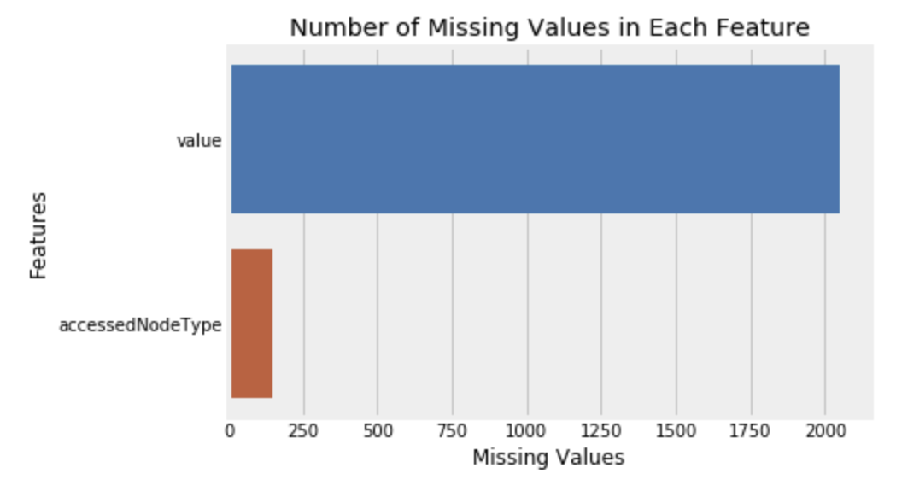
Data Preprocessing
Missing Values

Slide 18
Data Preprocessing
Missing Values - Value Column
2050 missing values.
2044 of them are anomalous connections (20%).
10623 unique values.
Data types: decimal, integer, boolean, none, and string.
Decision: drop the column.

Slide 19
Data Preprocessing
Missing Values - Accessed Node Type Column
Two relevant columns: accessed node address and accessed node type.
All null values came from the same addresses.
All these addresses have one type.
Decision: impute the missing value with this type.

Slide 20
4.
Data Cleaning & Feature Engineering

Slide 21
Data Cleaning & Feature Engineering
Transform the target to binary class (1: anomalous, 0: normal).
Split address columns.
Remove ‘/’ from columns.
Drop identical and duplicated columns.
Transform categorical variables into numerical variables.

Slide 22
Data Cleaning & Feature Engineering
Drop Identical and Duplicated columns
After splitting and cleaning the columns, and removing redundant data from some values, drop a column if
two columns are identical (total of 3).
two columns are duplicated (total of 2).

Slide 23
Data Cleaning & Feature Engineering
Transformation
245 columns

Slide 24
5.
Sampling

Slide 25
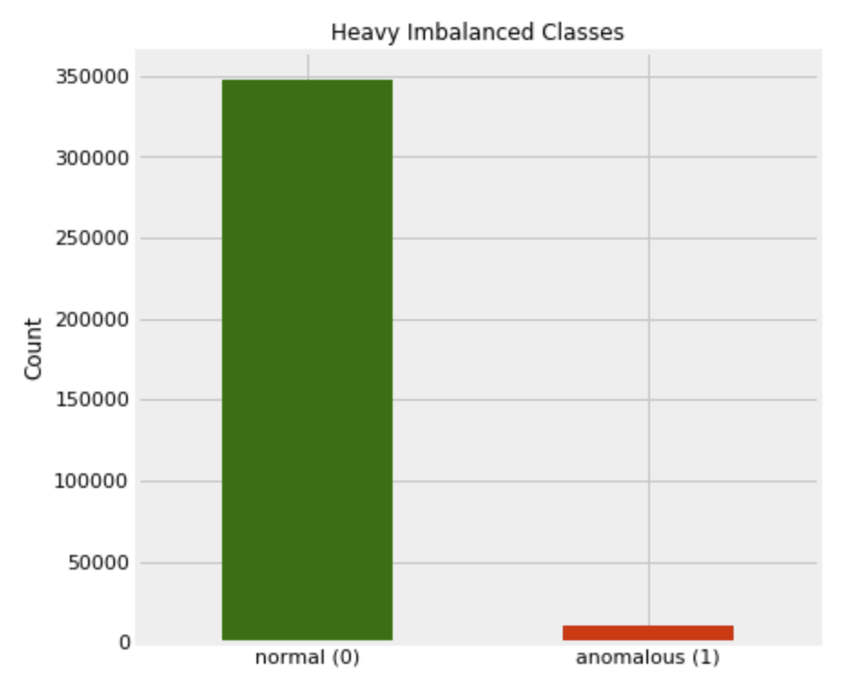
Sampling

Slide 26
Resampling - Synthetic Minority Oversampling (SMOTE)
Oversampling the minority class.
Duplicating examples in the anomalous connections.
These examples are synthesized from the existing data.

Slide 27
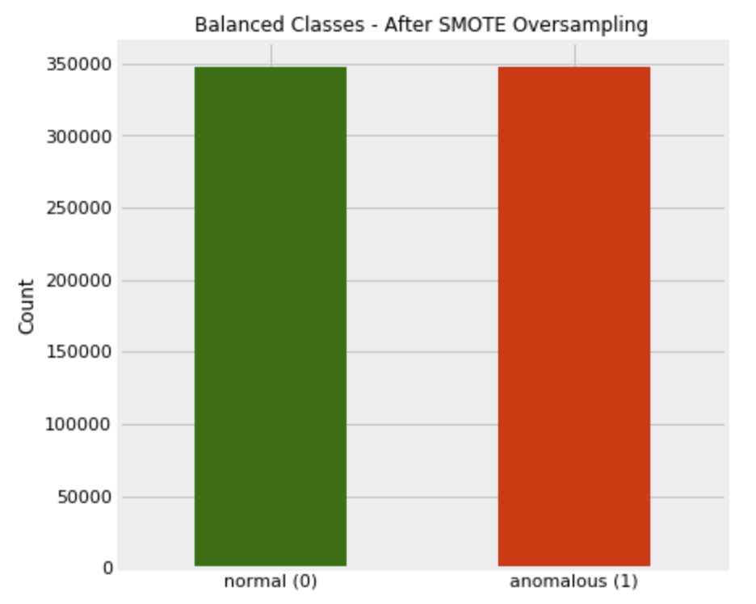
Resampling - Synthetic Minority Oversampling (SMOTE)
Dataset shape
695,870 rows.
245 columns.

Slide 28
6.
Modeling

Slide 29
Medelling
Type: Random forest.
Area Under Curve metrics used to help determine the parameters.
Different combinations of number of estimators, maximum depth, and maximum number of features have been applied.
Number of estimators: 25
Maximum depth: 10
Maximum number of features: 15

Slide 30
7.
Evaluation

Slide 31
Evaluation
Different measures have been used:
Accuracy, confusion matrix, classification report, feature importance scores, cross validation for training sets, ROC AUC for training and testing predictions.

Slide 32
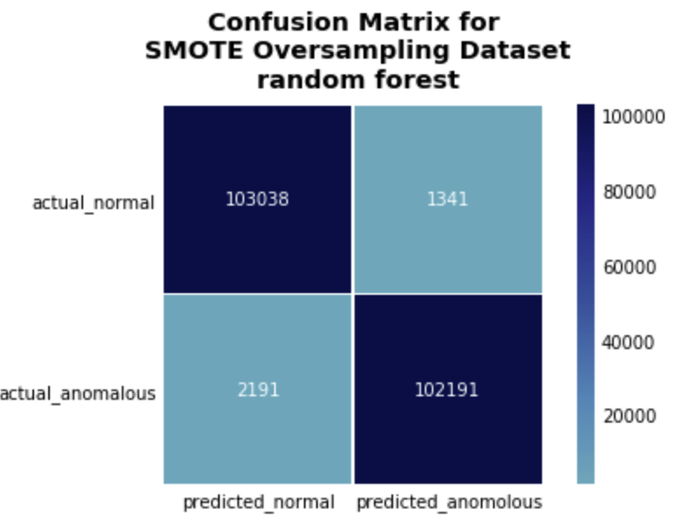
Evaluation
Baseline: 49.9%
Accuracy: 98.4%
Recall normal: 98%
Recall anomalous: 98%

Slide 33
Conclusion and Future Work
Conclusion.
Future work:
Try evaluation metrics on different sampling technique.
Multiclass classification.
Try other resampling technique.

Slide 34
Credits
Atzori, L., Iera, A. and Morabito, G., 2010. The internet of things: A survey. Computer networks, 54(15), pp.2787-2805.
Kaggle.com. 2020. DS2OS Traffic Traces. [online] Available at: <https://www.kaggle.com/francoisxa/ds2ostraffictraces>
Pahl, M.O. and Aubet, F.X., 2018, November. All eyes on you: Distributed Multi-Dimensional IoT microservice anomaly detection. In 2018 14th International Conference on Network and Service Management (CNSM) (pp. 72-80). IEEE.
Presentation template by SlidesCarnival

Slide 35
Thank you for listening

